Slide 1
STATISTICAL MACHINE LEARNING
BY
RAMESH DADI

Slide 2
Statistical theory
Involves the study of how to collect, analyze, interpret, and present data.
Descriptive statistics summarize and describe the main features of a dataset. Here are the key measures of descriptive statistics along with their mathematical expressions:
Mean is the sum of all the values in a dataset divided by the number of values.
Median is the middle value when the data is sorted in ascending order. If the number of observations is even, it is the average of the two middle values.
Mode is the value that appears most frequently in a dataset.
Variance measures the spread of the data points around the mean.
Standard deviation is the square root of the variance.
Range is the difference between the maximum and minimum values in the dataset.

Slide 3
Interquartile Range (IQR):-is the range of the middle 50% of the data, calculated as the difference between the third quartile (Q3) and the first quartile (Q1).
Skewness: measures the asymmetry of the probability distribution of a real-valued random variable about its mean.
Kurtosis measures the "tailedness" of the probability distribution of a real-valued random variable.
Percentiles and Quartiles: Percentile Pk is the value below which k% of the data falls.
Quartiles divide the data into four equal parts:
Q1 (25th percentile)
Q2 (50th percentile, median)
Q3 (75th percentile)

Slide 4
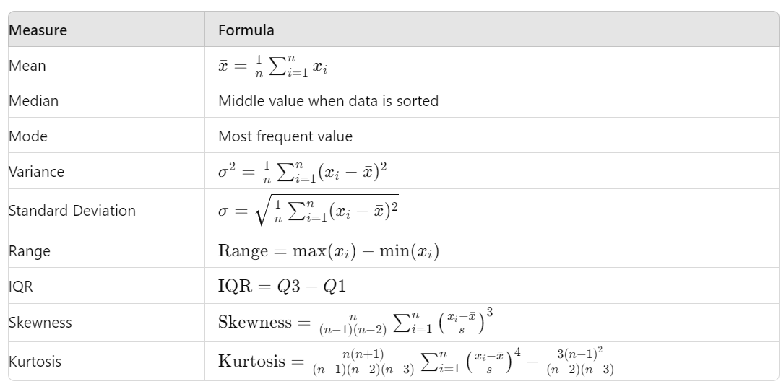

Slide 5
[1, 2, 3, 4, 5, 6, 7, 8, 9, 10]
first quartile Q1 and Q3:
Q1=(n+1)/4 data point
Q1=2+0.75×(3−2)=2+0.75=2.75
Q3=(3(n+1))/4 data point
Q3=8+0.25×(9−8)=8+0.25=8.25

Slide 6
What is Machine Learning?
Machine learning is a set of methods that can automatically detect patterns in data.
These uncovered patterns are then used to predict future data, or to perform other kinds of decision-making under uncertainty.
The key premise is learning from data!!

Slide 7
Examples of Learning Problems:
Machine learning plays a key role in many areas of science, finance and industry:
Predict whether a patient, hospitalized due to a heart attack, will have a second heart attack. The prediction is to be based on demographic, diet and clinical measurements for that patient.
Predict the price of a stock in 6 months from now, on the basis of company performance measures and economic data.
Identify the numbers in a handwritten ZIP code, from a digitized image.
Estimate the amount of glucose in the blood of a diabetic person, from the infrared absorption spectrum of that person’s blood.
Identify the risk factors for prostate cancer, based on clinical and demographic variables.

Slide 8
The Learning Problem
Learning from data is used in situations where we don’t have any analytic solution, but we do have data that we can use to construct an empirical solution
The basic premise of learning from data is the use of a set of observations to uncover an underlying process.

Slide 9
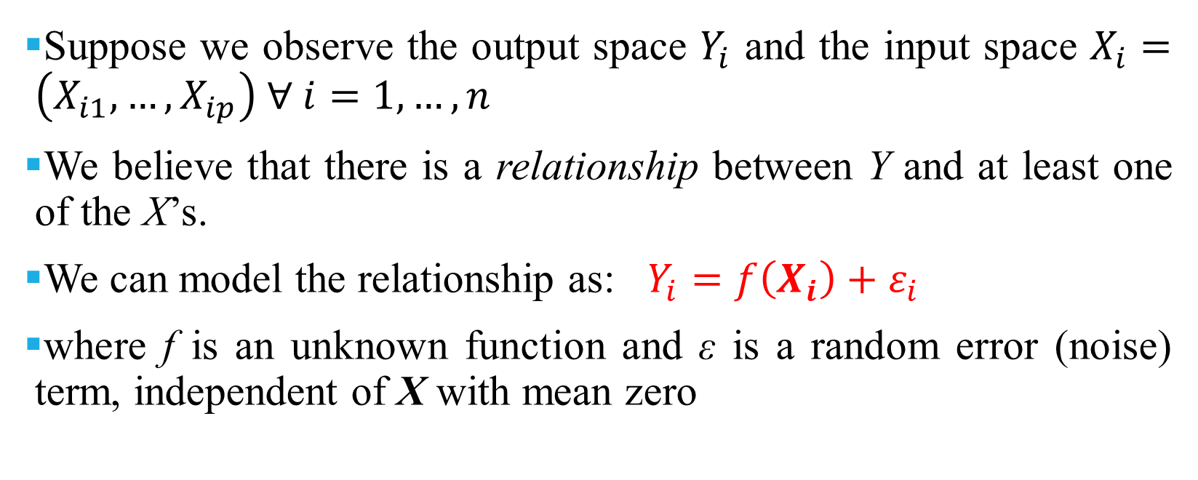
The Learning Problem (cont.)
Suppose we observe the output space $Y_{i}$ and the input space $X_{i}=\left(X_{i1},…,X_{ip}\right) ∀ i=1,…,n$
We believe that there is a relationship between Y and at least one of the X’s.
We can model the relationship as: $Y_{i}=f\left(X_{i}\right)+ε_{i}$
where f is an unknown function and ε is a random error (noise) term, independent of X with mean zero

Slide 10
Bayes
Bayes Theorem is a method to determine conditional probabilities – that is, the probability of one event occurring given that another event has already occurred.
Because a conditional probability includes additional conditions – in other words, more data – it can contribute to more accurate results.
P(H | X) = [ P(X | H) * P(H) ] / P(X)

Slide 11
Consider a general example: X is a vector consisting of ‘n’ attributes, that is, X = {x1, x2, x3, …, xn}.
Say we have ‘m’ classes {C1, C2, …, Cm}. Our classifier will have to predict X belongs to a certain class. The class delivering the highest posterior probability will be chosen as the best class. So mathematically, the classifier will predict for class.
Ci if P(Ci | X) > P(Cj | X).
P(Ci | X) = [ P(X | Ci) * P(Ci) ] / P(X)
P(class | X1, X2, …, Xn) = P(X1|class) * P(X2|class) * … * P(Xn|class) * P(class) / P(data)
We can also drop the probability of observing the data as it is a constant for all calculations, for example:
P(class | X1, X2, …, Xn) = P(X1|class) * P(X2|class) * … * P(Xn|class) * P(class)

Slide 12
A bookstore manager has information about his customers’ age and income. He wants to know how book sales are distributed across three age-classes of customers: youth (18-35), middle-aged (35-60), and seniors (60+).
Let us term our data X. In Bayesian terminology, X is called evidence. We have some hypothesis H, where we have some X that belongs to a certain class C.
Our goal is to determine the conditional probability of our hypothesis H given X, i.e., P(H | X).
by determining P(H | X), we get the probability of X belonging to class C, given X.
X has attributes of age and income – let’s say, for instance, 26 years old with an income of $2000. H is our hypothesis that the customer will buy the book?

Slide 13
Age | Income | Student | Credit_Rating | Buys_Book
Youth | High | No | Fair | No
Youth | High | No | Excellent | No
Middle_aged | High | No | Fair | Yes
Senior | Medium | No | Fair | Yes
Senior | Low | Yes | Fair | Yes
Senior | Low | Yes | Excellent | No
Middle_aged | Low | Yes | Excellent | Yes
Youth | Medium | No | Fair | No
Youth | Low | Yes | Fair | Yes
Senior | Medium | Yes | Fair | Yes
Youth | Medium | Yes | Excellent | Yes
Middle_aged | Medium | No | Excellent | Yes
Middle_aged | High | Yes | Fair | Yes
Senior | Medium | No | Excellent | No

Slide 14
X = {age = youth, student = yes, income = medium, credit_rating = fair}=?
Hence, P(buys_book = yes) = 9/14 = 0.643
P(buys_book = no) = 5/14 = 0.357
P(age = youth | buys_book = yes) = 2/9 = 0.222
P(age = youth | buys_book = no) =3/5 = 0.600
P(income = medium | buys_book = yes) = 4/9 = 0.444
P(income = medium | buys_book = no) = 2/5 = 0.400
P(student = yes | buys_book = yes) = 6/9 = 0.667
P(student = yes | buys_book = no) = 1/5 = 0.200
P(credit_rating = fair | buys_book = yes) = 6/9 = 0.667
P(credit_rating = fair | buys_book = no) = 2/5 = 0.400

Slide 15
Using the above-calculated probabilities, we have
P(X | buys_book = yes) = 0.222 x 0.444 x 0.667 x 0.667 = 0.044
Similarly,
P(X | buys_book = no) = 0.600 x 0.400 x 0.200 x 0.400 = 0.019
Which class does Ci provide the maximum P(X|Ci)*P(Ci)? We compute:
P(X | buys_book = yes)* P(buys_book = yes) = 0.044 x 0.643 = 0.028
P(X | buys_book = no)* P(buys_book = no) = 0.019 x 0.357 = 0.007

Slide 16
Bayesian versus Non-Bayesian approaches
Bayesian | Non-Bayesian
Bayesian statistics looks quite different, and this is because it is fundamentally all about modifying conditional probabilities . | Classical statistics uses techniques such as Ordinary Least Squares and Maximum Likelihood – this is the conventional type of statistics.
The parameter is a random variable. | The parameter is not a random variable.
the parameter is a random variable (no right answer) | the parameter is a fixed quantity (no probability about it)
it makes sense to talk about your method’s quality and “getting the answer right” | intuitive definitions

Slide 17
Maximum likelihood
The Maximum Likelihood Estimation (MLE) method is an estimation procedure that, given a probabilistic model, estimates its parameters in such a way that they are most consistent with the observed data
Assume to have observations 𝒟 = 𝑦 1 , 𝑦 2 , … , 𝑦 6 , where 𝑦 𝑖 ∼ 𝒩 𝜇, 𝜎²

Slide 18
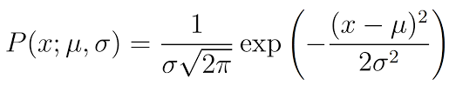
Maximum Likelihood Estimation
Defined the data vector 𝑌 = (𝑦 1 , 𝑦 2 , … , 𝑦 𝑁) ⊤. The joint pdf of the data vector 𝑌 is
The value assumed by the joint pdf 𝑓_{𝑌} 𝑌|𝜇, 𝜎² , with known 𝜇 and 𝜎², evaluated using the data 𝒟,
Maximizing the likelihood means maximizing this product

Slide 19
Maximum Likelihood Estimation
If function of the data 𝑌, the joint pdf is a multivariable distribution. But we know the value of 𝑌, since we observed those data
If we also knew 𝜇 and 𝜎, we could compute the probability of having observed 𝑌. But we do not know 𝜇 and 𝜎! That's exactly what we want to estimate!
When 𝑓_{𝑌}(𝑌|𝜇, 𝜎²) (the joint pdf) is seen as function of the parameters 𝜇 and 𝜎, it is called likelihood ℒ 𝜇, 𝜎² 𝑌

Slide 20
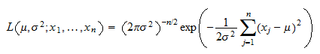
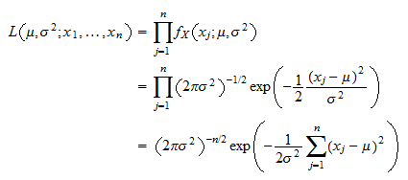
The likelihood function

Slide 21
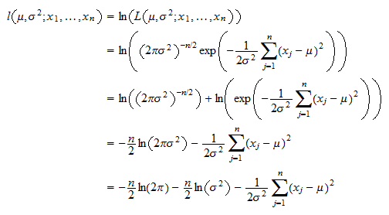
The log-likelihood function

Slide 22
parametric versus nonparametric methods
Parametric:
Select a form for the function.
Learn the coefficients for the function from the training data.
Some more examples of parametric machine learning algorithms include:
Logistic Regression
Linear Regression
SVM

Slide 23
Benefits of Parametric Machine Learning Algorithms:
Simpler: These methods are easier to understand and interpret results.
Speed: Parametric models are very fast to learn from data.
Less Data: They do not require as much training data and can work well even if the fit to the data is not perfect.
Limitations of Parametric Machine Learning Algorithms:
Constrained: By choosing a functional form these methods are highly constrained to the specified form.
Limited Complexity: The methods are more suited to simpler problems.
Poor Fit: In practice the methods are unlikely to match the underlying mapping function.

Slide 24
Nonparametric Methods
Algorithms that do not make strong assumptions about the form of the mapping function are called nonparametric machine learning algorithms.
By not making assumptions, they are free to learn any functional form from the training data.
Some more examples of popular nonparametric machine learning algorithms are:
k-Nearest Neighbors
Decision Trees like CART and C4.5

Slide 25
Benefits of Nonparametric Machine Learning Algorithms:
Flexibility: Capable of fitting a large number of functional forms.
Power: No assumptions (or weak assumptions) about the underlying function.
Performance: Can result in higher performance models for prediction.
Limitations of Nonparametric Machine Learning Algorithms:
More data: Require a lot more training data to estimate the mapping function.
Slower: A lot slower to train as they often have far more parameters to train.
Overfitting: More of a risk to overfit the training data and it is harder to explain why specific predictions are made.

Slide 26
Density Estimation
Probability Density:
A random variable x has a probability distribution p(x).
The relationship between the outcomes of a random variable and its probability is referred to as the probability density, or simply the “density.”
The shape of the probability density function across the domain for a random variable is referred to as the probability distribution and common probability distributions have names, such as uniform, normal, exponential, and so on.
can help to calculate moments of the distribution, like the mean and variance,

Slide 27
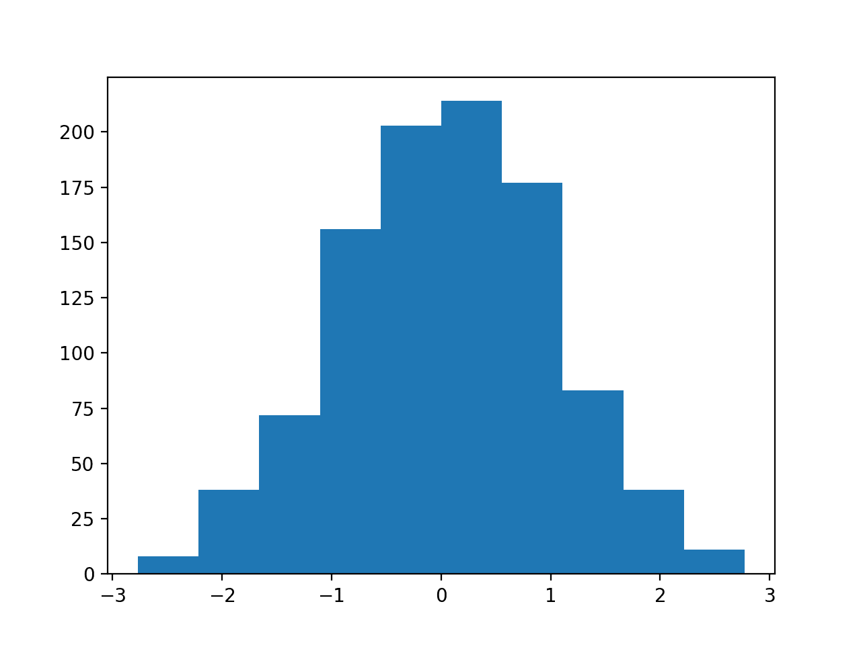
The first step is to review the density of observations in the random sample with a simple histogram.
A histogram is a plot that involves first grouping the observations into bins and counting the number of events that fall into each bin.
pyplot.hist(sample, bins=10)
pyplot.show()

Slide 28
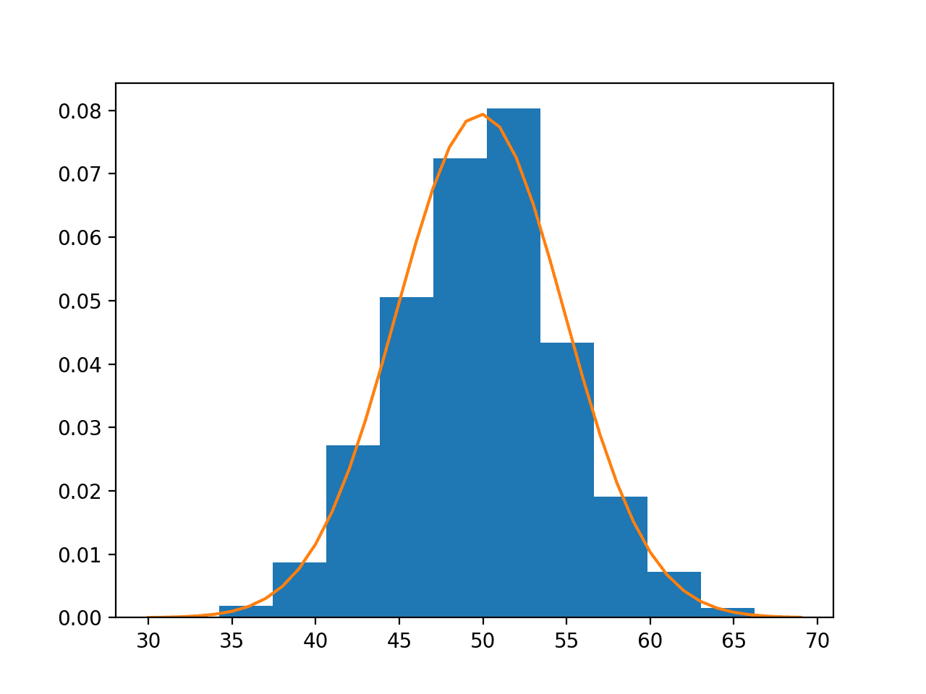
Parametric Density Estimation:
Once we have estimated the density, we can check if it is a good fit. This can be done in many ways, such as:
Plotting the density function and comparing the shape to the histogram.

Slide 29
Supervised vs. Unsupervised Learning
Supervised Learning:
All the predictors, X_{i}, and the response, Y_{i}, are observed.
Many regression and classification methods
Unsupervised Learning:
Here, only the X_{i}’s are observed (not Y_{i}’s).
We need to use the X_{i}’s to guess what Y would have been, and then build a model form there.
Clustering and principal components analysis

Slide 30
Supervised Learning

Slide 31
cont

Slide 32
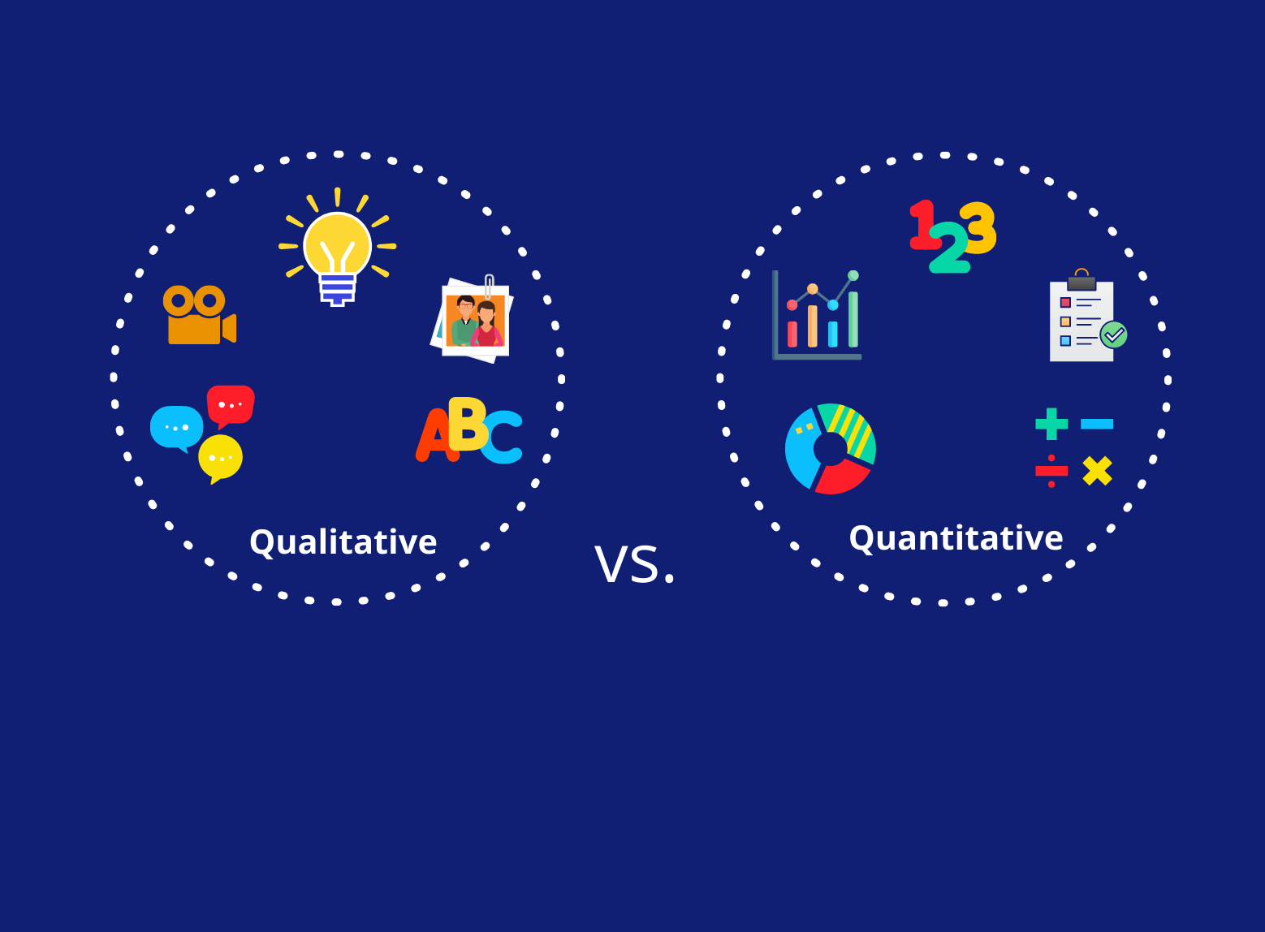
Terminology
Quantitative:
Measurements or counts, recorded as numerical values (e.g. height, temperature, etc.)
Qualitative: group or categories
Ordinal: possesses a natural ordering (e.g. shirt sizes)
Nominal: just name the categories (e.g. marital status, gender, etc.)

Slide 33
Supervised Learning: Regression vs. Classification
Regression
Covers situations where Y is continuous (quantitative)
E.g. predicting the value of the Dow in 6 months, predicting the value of a given house based on various inputs, etc.
Classification
Covers situations where Y is categorical (qualitative)
E.g. Will the Dow be up or down in 6 months? Is this email spam or not?

Slide 34
Supervised Learning: Examples
Handwritten Digit Recognition:
Identify single digits 0~9 based on images

Slide 35
Supervised Learning: Examples
Speech Recognition:
Identify words spoken according to speech signals
Automatic voice recognition systems used by airline companies, automatic stock price reporting, etc.

Slide 36
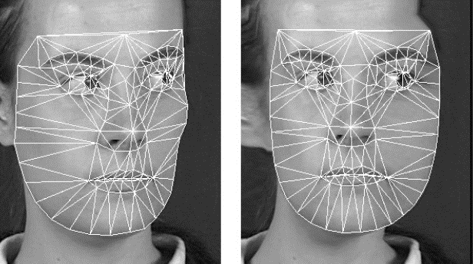
CONT:
Face Detection/Recognition:
Identify human faces

Slide 37
Supervised Learning: Linear Regression

Slide 38
Supervised Learning: K Nearest Neighbors

Slide 39
Unsupervised Learning

Slide 40
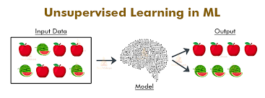
Unsupervised Learning (cont.)
The training data does not contain any output information at all (i.e. unlabeled data).
Viewed as the task of spontaneously finding patterns and structure in input data.
Viewed as a way to create a higher-level representation of the data and dimension reduction

Slide 41
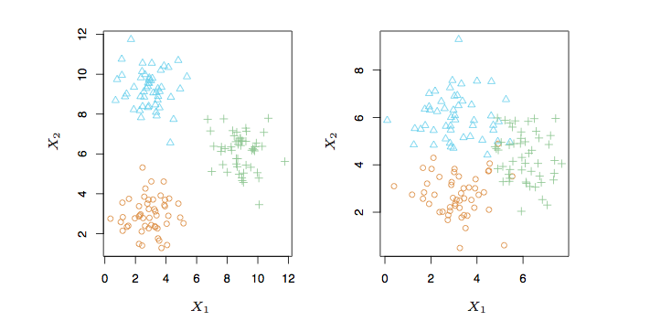
Unsupervised Learning: K-Means Clustering

Slide 42
You are given reviews of few Netflix series marked as positive, negative and neutral. Classifying reviews of a new netflix series is an example of____________
unsupervised learning
semi supervised learning
supervised learning
reinforcement learning

Slide 43
The problem of finding hidden structure in unlabeled data is called______________
unsupervised learning
reinforcement learning
supervised learning
None

Slide 44
Of the Following Examples, Which would you address using an supervised learning Algorithm?
given a set of news articles found on the web, group them into set of articles about the same story
given email labeled as spam or not spam, learn a spam filter
given a database of customer data, automatically discover market segments and group customers into different market segments
find the patterns in market basket analysis

Slide 45
Some telecommunication company wants to segment their customers into distinct groups ,this is an example of________________
supervised learning
unsupervised learning
data extraction
reinforcement learning

Slide 46
Imagine a Newly-Born starts to learn walking. It will try to find a suitable policy to learn walking after repeated falling and getting up. Specify what type of machine learning is best suited?
supervised
unsupervised
reinforcement learning
None

Slide 47
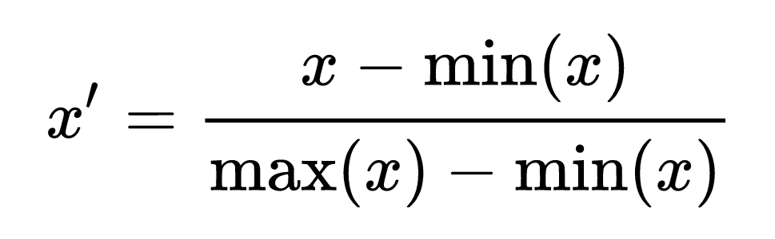
Min-Max normalization
Variables that are measured at different scales do not contribute equally to the model fitting & model learned function and might end up creating a bias.
Min-MaxScaler rescales the data set such that all feature values are in the range [0, 1]. This is done feature-wise in an independent way.

